Slide 1
Homework 7
Will Morgan

Slide 2
Make_2d
Make_2d generates a 2D array with specified dimensions and write it to a binary file. It accepts three command-line arguments: the number of rows, the number of columns, and the output file name. Upon execution, the program checks if the correct number of arguments is provided and prints a usage message if not. If the arguments are correct, it initializes a 2D array with the specified dimensions, setting boundary columns to 1.0 and interior columns to 0.0. The program then creates a DataOutputStream to write binary data to the specified output file. It writes the number of rows and columns to the file, followed by the data values of the 2D array. Exception handling is implemented to catch any IOException that may occur during file operations, printing the stack trace if an error occurs.

Slide 3
Print_2d
Print_2d reads a binary file containing data representing a 2D array and print its contents to the console. It expects a single command-line argument, which is the name of the input data file. If the correct number of arguments is not provided, the program prints a usage message and exits with an error code. Upon receiving the input file name, it creates a DataInputStream to read binary data from the file. The program then reads the number of rows and columns from the file and initializes a 2D array accordingly. It iterates through the array and populates it with the data read from the file. Finally, it prints the contents of the 2D array to the console, formatting each value with two decimal places. Exception handling is implemented to catch any IOException that may occur during file operations, printing the stack trace if an error occurs.

Slide 4
Stencil_2d
Stencil_2d performs a stencil computation on a 2D array of data. It takes three command-line arguments: the number of iterations to perform, the input file containing the initial array data, and the output file to store the computed results. Upon execution, the program reads the input file to obtain the dimensions of the array and its initial values. It then iteratively applies the stencil operation, which computes each cell's new value based on the average of its neighboring cells. The computation is repeated for the specified number of iterations. After each iteration, the updated array is written to the output file. Additionally, the program measures and reports the total execution time, including both computation and IO operations. Exception handling is implemented to catch any IO exceptions that may occur during file operations, printing the stack trace if an error occurs.

Slide 5
Display_image
Display_image reads data from a Java program, which prints a 2D array, and then plot a heatmap of the data using Matplotlib in Python. The script takes the filename of the input data file for the Java program as a command-line argument. It first runs the Java program using subprocess.Popen to execute the Java code and capture its output. If the execution is successful, it extracts the printed array from the Java output and parses it into a list of lists containing float values. Then, the script plots the heatmap using Matplotlib's contourf function to create filled contours and contour function to overlay contour lines with corresponding values. It also adds a color bar to indicate the heatmap's color scale and adjusts axis labels and ticks for better readability. Finally, it displays the generated heatmap plot. The script uses argparse to parse command-line arguments and provides usage instructions if incorrect arguments are provided.

Slide 6
Plot_data
Plot_data generates a line plot from data stored in a specified file and saves the plot as a PNG image. It takes two arguments: data_file, which is the path to the file containing the data to be plotted, and output_png, which is the filename for the PNG image to be generated. The function reads the data from the file, skipping the header line, and parses each line to extract the values representing different aspects of time. These values are stored in separate lists for N (the x-axis), total time (T), work time (T_W), and IO time (T_IO). Using Matplotlib, the function plots these lists against N, labeling each line appropriately. It also sets the axes labels and title for the plot, adds a legend, and enables a grid for better visualization. Finally, it saves the plot as a PNG file with the specified filename and displays the plot to the user. Additionally, the script ensures that the correct number of command line arguments is provided when running the script directly, providing usage instructions if incorrect.

Slide 7
Gather_data
Gather_data automates the process of running a series of Java programs with varying input parameters and capturing their output to a specified file. It takes four arguments: N, M, iterations, and output_file. The function iterates through a range of values from N to M, inclusive, and for each value, it first runs a Java program called "make_2d" with parameters N and M to create input data. Then, it executes another Java program named "stencil_2d" with the provided number of iterations, using the input data generated previously. The function captures the command line output of "stencil_2d" and writes it to the output file along with the current value of N. If an error occurs during the execution of "stencil_2d" for any value of N, it prints an error message and exits the program. The script also ensures that the correct number of command line arguments are provided when running the script directly.

Slide 8
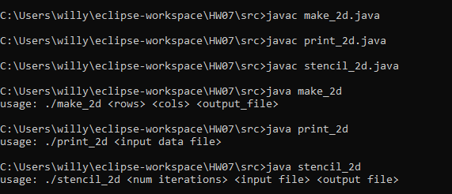
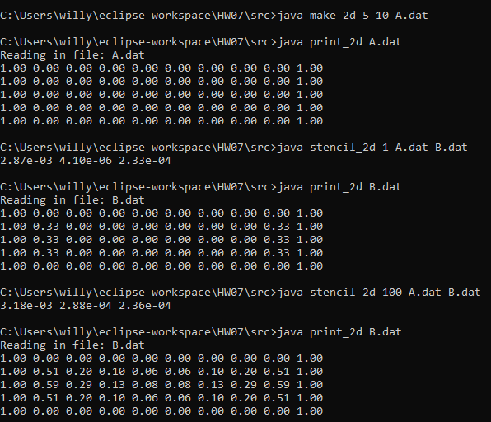


Usage and execution

Slide 9
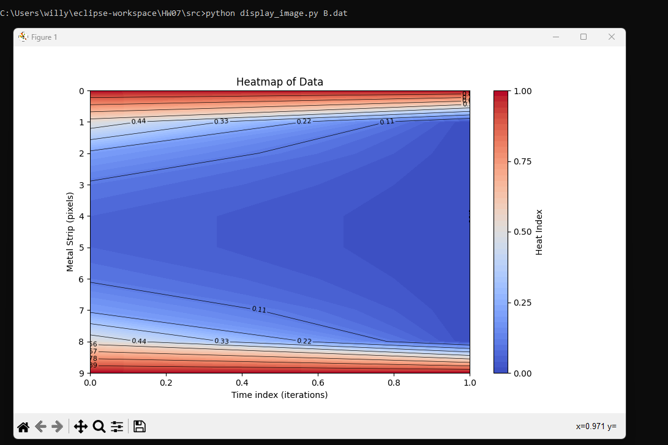
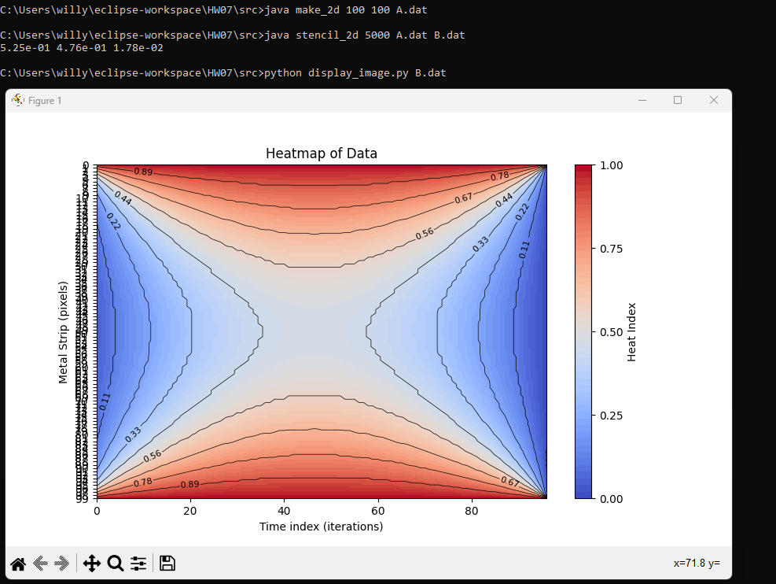
Heatmap of 5x10 100 iterations
Heatmap of 100x100 5000 iterations (y axis is 0-99)

Slide 10
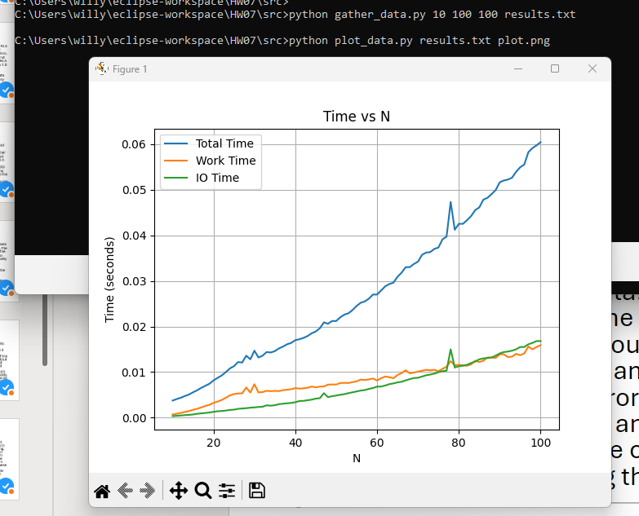
Plot of Total time, work time and IO time for the stencil_2d class. Gather data is gathering array sizes NxN to M. In this example, 10x10 to 100x100, then it plots the time it takes for each execution.

